Slide 1
Deployment and Operations for Software Engineers 2nd Ed
Chapter 11 – Deployment pipeline 2

Slide 2
Outline
Feature toggles
Deployment models
Partial deployments
Roll back/forward
Version skew

Slide 3
Feature toggles
Feature toggles are a mechanism to allow different versions of the same service to be simultaneously active.
Feature toggles are “if” statements that make the new code for a service version conditional so that the new code executes only when the feature toggle is on. If the feature toggle is off, then the old code of the microservice is executed.
Feature toggles should be removed from the code when no longer needed.

Slide 4
Installing vs activating a service
When using feature toggles a new version is installed with the feature toggled off and when it is time to activate the feature, it is toggled on.
The value of the feature toggle, whether toggled on or off, is maintained by a distributed coordination system so that all the instances of the microservice are toggled on–or off–at the same time.
We will see several possible uses for feature toggles

Slide 5
Outline
Feature toggles
Deployment models
Partial deployments
Roll back/forward
Version skew

Slide 6
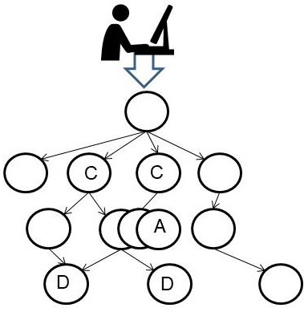
Service graph for your system
Updating Service A
Clients C
Dependencies D

Slide 7
Deployment
Assumptions
You are performing continuous deployment of an upgrade to a service.
Image to be deployed is on a staging server.
The current version of the service (Service A) is to be replaced by a new version of the service (Service A’).
There are N instances of Service A currently executing.
There is to be no reduction of service to the clients during the upgrade.
The deployer has the appropriate credentials for installing new version.

Slide 8
Goal of deployment
The goal is to have N instances of Service A’ executing and no instances of Service A

Slide 9
Basic deployment strategies
Blue/Green.
Create N instances of Service A’.
Route incoming messages to Service A’ instances
Drain and delete instances of Service A.
Rolling Upgrade
Allocate a new instance.
Install Service A’.
Begin to direct requests to new instance of Service A’.
Drain Service A from one instance and then destroy that instance.
Repeat above steps until all instances have been replaced.

Slide 10
Tradeoffs
Financial. The peak resource utilization for a blue/green approach is 2N instances, whereas peak utilization for a rolling upgrade is N+1 instances.
Responding to errors. Suppose you detect an error in Service A’ when you deploy it. If you are using blue/green deployment, by the time you discover an error in Service A’, all the instances of Service A may have been deleted and rolling back to Service A could take some time. In contrast, a rolling upgrade may allow you to discover an error in Service A’ while instances of Service A are still available.

Slide 11
Outline
Feature toggles
Deployment models
Partial deployments
Roll back/forward
Version skew

Slide 12
Partial deployments
You may not wish to replace all of the instances of Service A
Canary testing
A/B testing

Slide 13
Canary testing
Canary testing means to designate a set of testers who will use a new release.
Sometimes, these testers are so-called power users or preview-stream users from outside your organization.
Another approach is to use testers from within the organization that is developing the software. For example, Google employees almost never use the release that external users would be using, but instead act as testers for upcoming releases.

Slide 14
Implementing canary testing
The testers get access to the canaries through DNS settings or through discovery-service configuration.
After testing is complete, either the system is returned to its original version, or the new version is rolled out to all users.

Slide 15
A/B testing
A/B testing is used by marketers by performing an experiment with real users to determine which of several alternatives yields the best business results.
A small but meaningful number of users receives a different treatment from the remainder of the users.
The two categories are compared based on a business metric specific to the organization.

Slide 16
Implementing A/B testing
The implementation of A/B testing is the same as the implementation of canary testing.
Discovery services are set to send requests to different versions and the different versions are monitored to see which one provides the best response from a business perspective.
Feature toggles can also be used to control which version users see.

Slide 17
Outline
Feature toggles
Deployment models
Partial deployments
Roll back/forward
Version skew

Slide 18
Roll back
Use in production may uncover functional or quality issues that require a version to be replaced. Two options exist for replacing a release: roll back and roll forward.

Slide 19
Roll back
Roll back means replacing the current version with an earlier version. This may involve discontinuing the deployment of the new release and redeploying a previous release that is known to meet your quality goals. It could also be accomplished by turning off the feature toggle used to activate the new release.

Slide 20
Roll Forward
Roll forward means fixing the problem and generating a new version. This generally requires you to debug the problem and then be able to test and deploy the new version quickly.

Slide 21
Outline
Feature toggles
Deployment models
Partial deployments
Roll back/forward
Version skew

Slide 22
Version skew
You are updating Service A
Services C (clients) and D (dependencies) may or may not have been updated.
This results in inconsistent versions of the services.
Version skew is the term given to inconsistent versions of services simultaneously being in production.
Two types
temporal inconsistency
interface mismatch.

Slide 23
Version skew example
Assume that Service A is a shopping-cart service that allows clients to add items to a basket and calculates the total price including discounts.
You are updating the service to shift from calculating the discount item-by-item to calculating the discount based on the complete purchase.
This change requires changes to Services A, its clients (C), and its dependent services (D).

Slide 24
Temporal inconsistency
A request by client C to your service may be served by an instance running Service A.
The return to client C will be a response that is based on Service A.
Service C then makes a second call to your service using the response
data, which may be served by an instance running Service A’.
In the shopping cart example, the result is a cart in which some items are discounted twice–once as a single item by the Service A instance, and again when the Service A’ instance discounted the entire cart.

Slide 25
Interface mismatch
The interface in Service A’ has changed from the interface in Service A
If Service C calls Service A’ with an interface designed for Service A, an interface mismatch would occur.
Interface mismatch can occur whenever the update from Service A to Service A’ involves changing the interface of Service A.

Slide 26
Interface mismatch
Avoiding interface mismatch requires that any client of Service A be able to call Service A’ and get a correct response, regardless of whether the request is serviced by Service A or Service A’.
Service A must handle the cases
Client C assumes that Service A has been upgraded but it has not,
Client C does not assume Service A has been upgraded with an interface change.

Slide 27
Avoiding version skew
Two techniques
Tagging messages
Feature toggles

Slide 28
Tagging messages
Tag messages with the expected version of the recipient.
It is the responsibility of the recipient to respond appropriately.
If Service A’ received a message tagged with A, it should interpret it as conforming to the interface of Service A.

Slide 29
Interface compatibility
Backward compatibility is supporting an outdated interface.
Forward compatibility is being graceful when receiving a message tagged with a future interface version.
The service should respond with an error message indicating that it does not recognize calls to this version
The client then must be able to handle such an error message.
The client can try again hoping to be routed to an instance that supports the version it expects
fall back to a different method of achieving its goal,
report failure to its invoker.

Slide 30
Achieving Backwards Compatibility
Backward compatibility is achieved using a translation layer
Client
Client
External APIs for current and previous version
Translation to internal APIs for current version
Internal APIs (changes require changes to translation layer but do not propagate further)

Slide 31
Using feature toggles
Write new code for Service A’ under control of a feature toggle.
Install N instances of Service A’ using either the Blue/Green or the Rolling Upgrade approach. When a new instance is installed, begin sending requests to it without introducing any version skew, as the new code is toggled off.
When all instances of Service A are running Service A’, activate the new code using the feature toggle. Use a distributed coordination service to ensure that all instances are turned on simultaneously

Slide 32
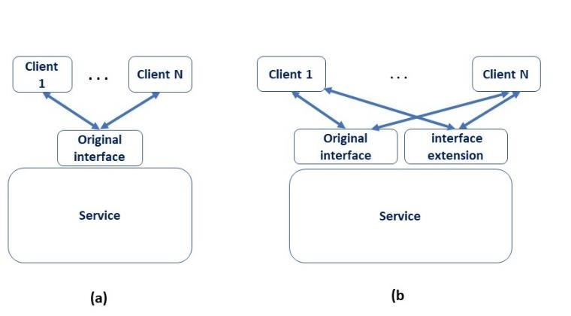
A different approach to interface mismatch
Extending an interface can also be used to manage interface mismatch.
fields in an interface extension have different names than the fields in the original interface.
(a) shows original interface and (b) shows an extended interface
•

Slide 33
Database schema evolution
All writers and all readers must agree on the schema whether the schema is explicit (e.g. relational) or implicit (e.g. key, value)
Well known and difficult problem,
One approach is to treat a schema as you treat an extended interface.
The schema can be extended, but existing data remains valid.
Any version of a service will access data using field identifiers that it knows are supported,

Slide 34
Tool support for database evolution
In some cases, you can use tools that convert data from one schema to another while leaving the database online.
Thisautomatic conversion requires you to write specific translation routines to derive the new elements of the schema from the existing form.

Slide 35
Discussion questions
How many past interfaces should a service support?
During a rolling upgrade, how does the system decide which instance to replace?
How would a tool that automatically converts from one database schema to another be used?
What is the cost difference between canary testing and A/B testing?

Slide 36
END OF PART 2 OF CHAP 11

